Slide 1

Mismatched training and dev/test data
Training and testing on different distributions
deeplearning.ai

Slide 2
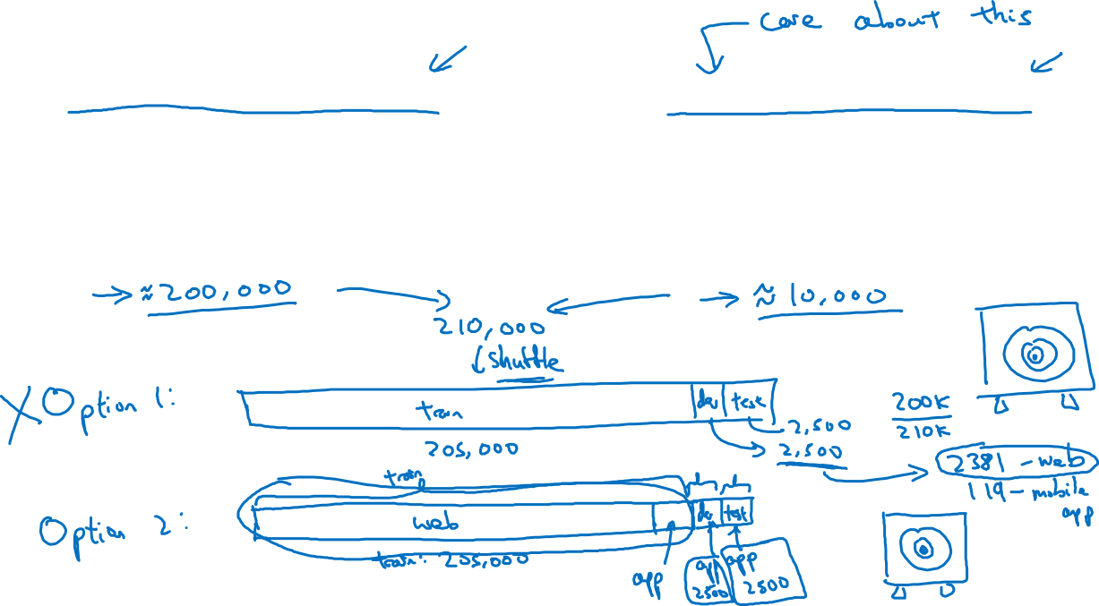
Cat app example
Data from webpages
Data from mobile app

Slide 3
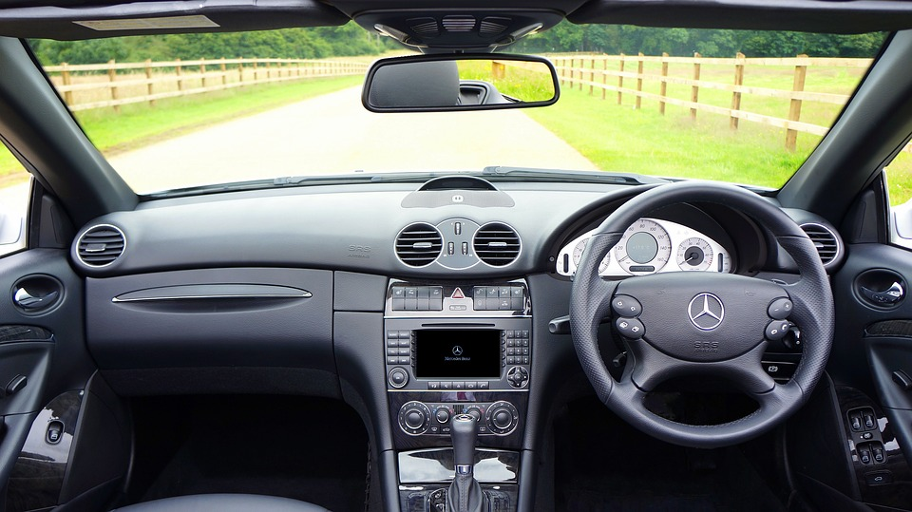
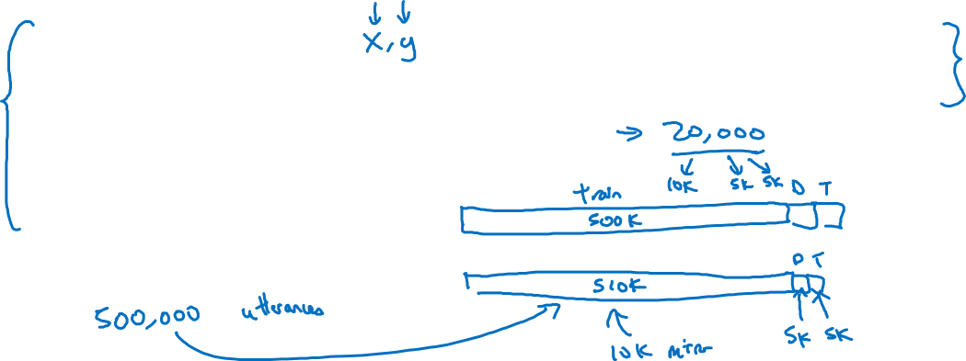
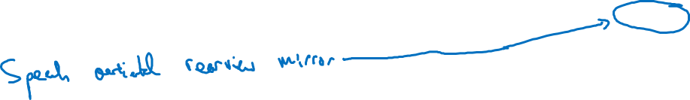
Speech recognition example
Training
Dev/test
Purchased data
Speech activated rearview mirror
Smart speaker control
Voice keyboard
…

